Slide 1

Rohin Bhagat, Samuel Gankin, Riya Patibandha, Connor Tarrant, Eric Yu

Slide 2

Company Overview

Slide 3
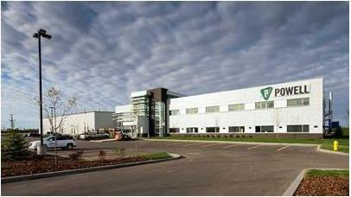
Powell Industries, Inc.
Founded in 1947 as a metal shop to support local petrochemical operations in Texas
Now a global operation serving many market segments
Known to provide complex and integrated systems for electrical energy distribution
  Designs and manufactured custom-engineered electrical equipment
Brett Alan Cope: Chairman, President, and CEO
Products and services include substations, switchgears, monitor control centers, and integrated power systems (B2B model)
FY24 Revenue: $1.012 billion; 45% increase from FY23
Market Cap: $3.89 billion
Notes:
Riya

Slide 4
SWOT Analysis

Slide 5
Strengths
Specialized product offerings
Weaknesses
Small market cap
Threats
Intense Competition in EE industry
Opportunities
Geographic Expansion (ex. Asia)
Extensive manufacturing
Positive Revenue Growth
Significant concentration in North American market
Dependence on industrial and utility sector
Raw Material Price Volatility
Tap into growing markets (ex. EV charging infrastructure and smart grid technology)
Notes:
Riya

Slide 6
Industry Overview

Slide 7
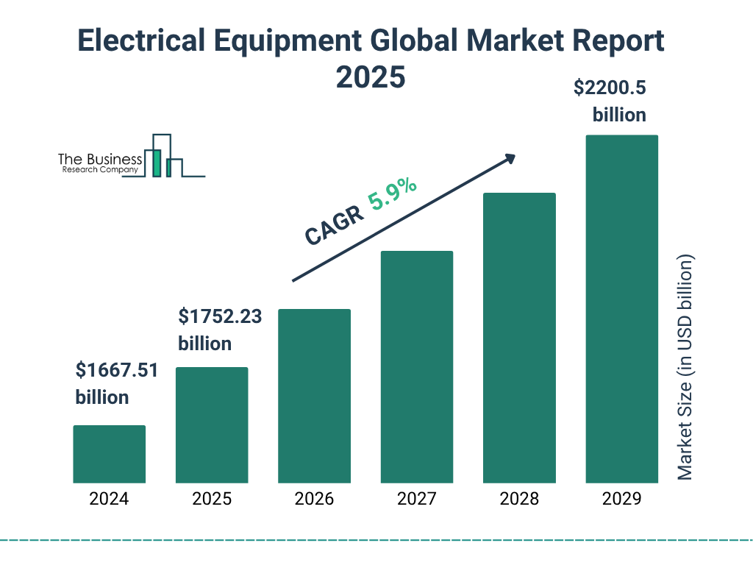
Industry Overview: Electrical Equipment
Well-established electrical and industrial companies (Siemens, Eaton, and ABB) take up majority of the market share
Moderate level of competition; expected to increase
Market Size (2024): $1,513.22 billion
  Forecasts for 2032: $3,326.86 billion
Moderate level of growth while battling persistent volatility
  Trade policies, unpredictable raw material costs, and rising interest rates
Notes:
Riya

Slide 8
Porter’s Five Forces

Slide 9
Threat of New Entrants: LOW
Bargaining Power of Suppliers: LOW-MEDIUM
Threat of Substitute Products: LOW-MEDIUM
Bargaining Power of Buyers: MEDIUM-HIGH
Degree of Competitive Rivalry in the Industry: MEDIUM-HIGH
Powell’s decades of experience and strong supplier relationships make it hard for new players to compete
Starting a company like Powell requires massive upfront costs and strict safety regulations
Powell buys in large quantities, which helps them negotiate better deals than smaller firms
Only a few custom components give certain suppliers extra leverage, but not enough to control Powell
Big industrial clients can push for lower prices because they buy in bulk
Powell’s custom systems are hard to replace, which keeps buyers from switching easily
Powell doesn’t face many substitutes because their products are highly specialized
Future software-based control systems could become a threat as technology keeps growing
The industry has major global competitors, making big project bids competitive
Powell stands out in specialized, engineering-heavy jobs where reliability matters more than size
Notes:
Samuel

Slide 10
Investment Thesis
POWL is a BUY
Due to its healthy backlog, recent strategic acquisitions, and robust balance sheet, which provides both stability and growth potential, positioning it well to benefit from long-term trends in electrification and infrastructure modernization.
Notes:
Eric

Slide 11
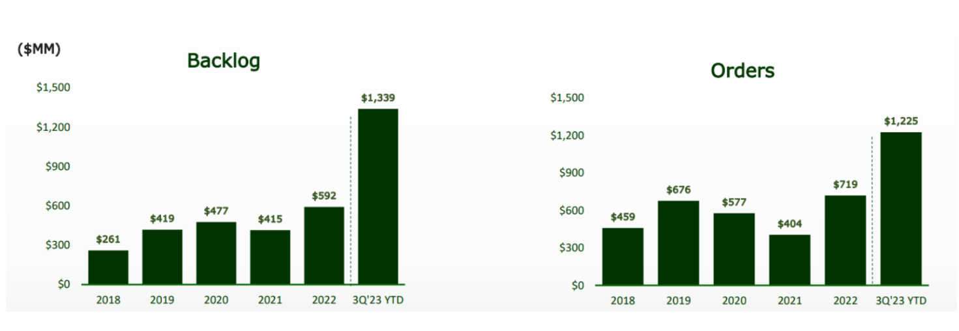
1. Healthy Backlog
FY25 Q3: $1.4 billion backlog; record-breaking level
  5% increase from the prior year
  More backlog than revenue
Projects about $849 million of its backlog to be converted into revenue in the future
Backlog = work that is already guaranteed = predictable revenue stream
  Committed to completing more work than it provided in FY25, indicating a higher revenue for FY26.
Industrial companies with engineer-to-order products have a very high backlog conversion rate.
  POWL tends to convert 70-85% of its backlog into revenue in less than 18 months.
Notes:
Eric

Slide 12

2. Strategic Acquisition
August 2025: Completed acquisition of Remsdaq Ltd
  Specializes in remote terminal units (RTUs) for various electrical utilities and integrated security systems such as access control and perimeter breach detection
Expands POWL’s reach and improves its automation and software by filling a gap in its’ product portfolio
Core competency: low to medium-voltage switchgear.
  Data centers are demanding automated systems that can provide real-time information to the company regarding electrical operations = done through RTU systems
POWL can now offer a fully integrated power package with automation in mind.
Acquisition expands their capabilities as an electrical equipment company and transforms their product offerings,
  Ensuring they are providing the best to their customers and staying relevant in the competitive industry.
POWL is aware of the gaps it needs to fill and is actively working on improving itself to ensure long-term growth and stability.
Notes:
Eric

Slide 13
3. Robust Balance Sheet
FY25 Q3: $433 million in cash or short-term investments,
  Gives POWL the opportunity to make more acquisitions, invest, and absorb volatility.
Cash provides for a strong buffer against any unexpected project delays.
  Funding capital expenditures or making more strategic acquisitions without taking on significant debt (no debt disclosed in FY25 Q3 earnings report)
Generated about $168 million in operating cash flow in FY25
Not only does POWL have cash on hand, but it is also able to generate cash from its business operations.
Current Ratio | 2.06 | POWL can comfortably meet short-term obligations
Debt-to-Equity Ratio | 0 | Debt-Free
Cash-to-Assets Ratio | 0.4 | Significant portion of assets are held in cash
Via GuruFocus
Notes:
Rohin
Debt-Equity Ratios of Other Companies in the Industry: (say if asked)
BIGGER COMPANIES IN INDUSTRY
Siemens = 0.94
ABB = between 0.61-0.64
POWL-SIZED COMPANIES IN INDUSTRY
Franklin Electric Co Inc = 0.20-0.21
Is being debt free common in the EE industry? No because many companies use financing for expensive equipment purchases. The EE industry relies on capital investments

Slide 14
Risks and Mitigants

Slide 15

Competition and Market Share
Risk: Heavy competition from larger global corporations in the industry, such as ABB and Siemens
POWL has a significantly lower market share (3.25%) compared to bigger competitors like ABB (4.9%) and Siemens (~40%).
Competitors can spread their fixed costs across a larger base = lower average cost per unit than smaller companies = economies of scale
Mitigant: Emphasize product offerings built on customization, speed, and high-class services
Larger companies = standardized and high-volume products
POWL = customized, engineer-to-order products
Notes:
Samuel
Points to mention orally:
Risk: Larger global competitors offer robust product lines and have higher R&D budgets.
Mitigant: Larger companies tend to shy away from this responsibility, since it slows down production, but POWL capitalizes on this need in the market, allowing them to gain the business of people whose needs can’t be satisfied by bigger companies

Slide 16

High Backlog Risk
Risk: High backlog risk in the event of project cancellations and delays
Large industrial projects are funded by oil and gas capex budgets and public infrastructure funding cycles
  Reduces POWL’s expected revenue
  Lower factory utilization than originally anticipated.
Mitigant: POWL is not dependent on one industry cycle and includes contractual items that reduce customer cancellations
Diversification in market segments reduces the risk of any sudden volatility
Cancellation penalties are thorough
Nonrefundable deposits and up-front payments
Notes:
Rohin
Points to mention orally:
Risk:
After first bullet point (“Large industrial projects…”), add on: if macro conditions were to change, there is always a risk of customers beginning to cancel their project requests.
Move to sub bullets
After sub bullets: If a customer were to delay a project, POWL won’t be able to recognize revenue, and this can slow growth and build up inventory.
Mitigant:
After cancelletion penalities bullet, add on: include money for the work that has already been completed, the work that is in progress, and the materials acquired for the project.
- After nonrefundable deposits bullet, add on: ensure that POWL is still able to collect some portion of revenue in the event of a cancellation

Slide 17
Financial Analysis

Slide 18
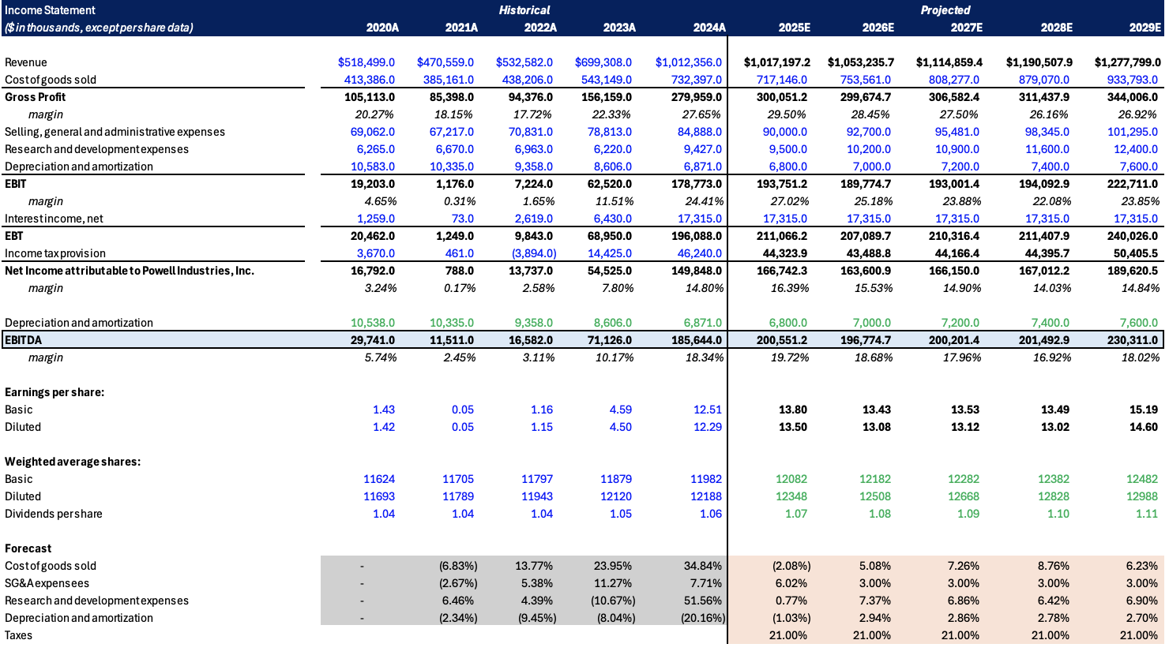
Income Statement
Notes:
Connor

Slide 19
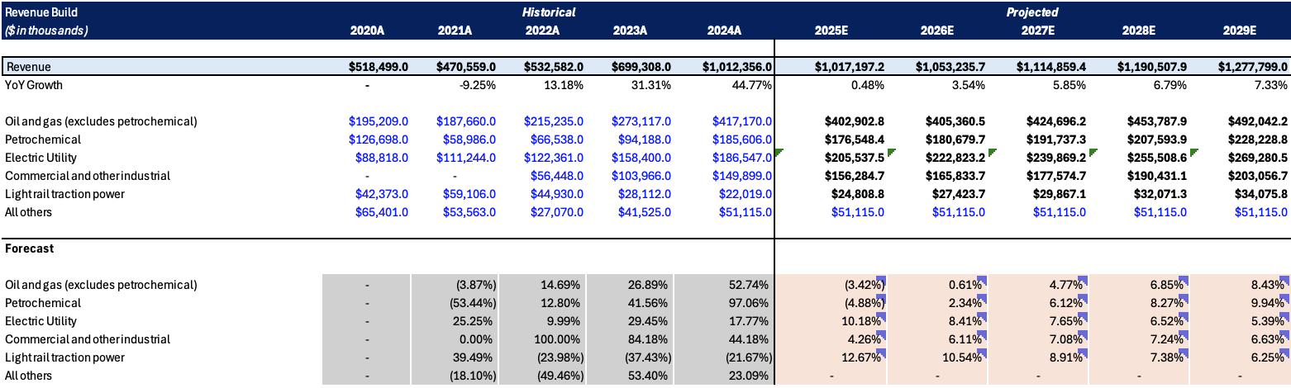
Revenue Build & Projections
Notes:
Samuel

Slide 20
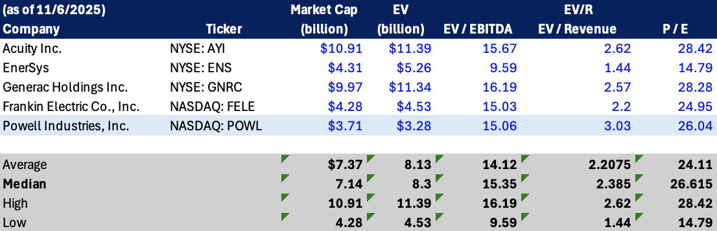
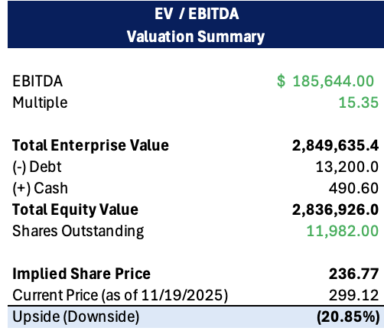
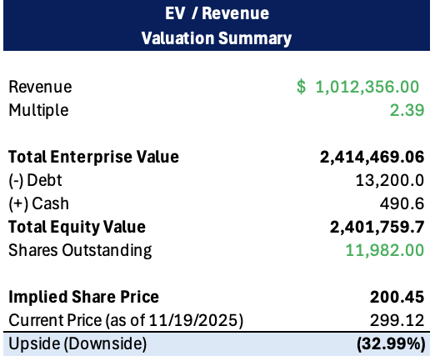
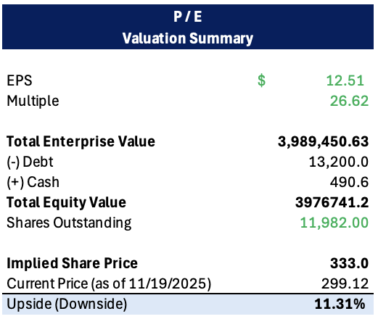
Comps & Valuation
Notes:
Connor

Slide 21
Questions?

